Slide 1


Slide 2
Introduction to Hydraulics
Gui Cavalcanti
4/17/2012

Slide 3
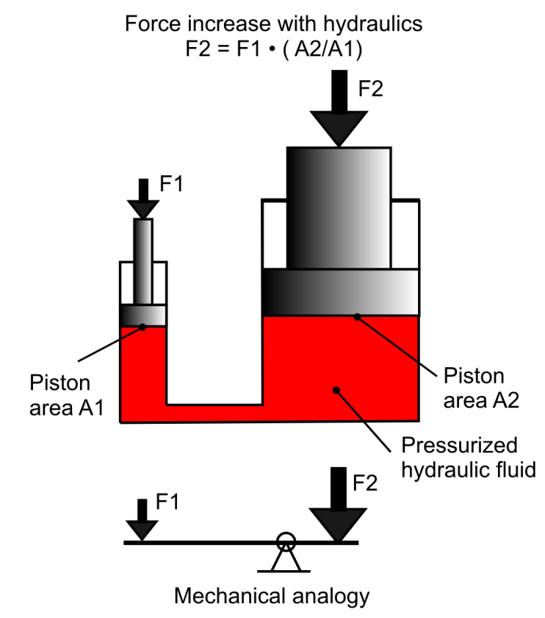
Definition
Transmission of mechanical power via incompressible liquids
Hydraulic Power = Flow X Pressure
Pressure X Area = Force
Flow / Area = Velocity
“Liquid gearing”

Slide 4
Typical Hydraulic System
One centralized powerplant
Constant pressure (1,500 to 5,000 psi)
Variable (demand-based) flow rate
Flow-control or on/off valves controlling individual actuators

Slide 5
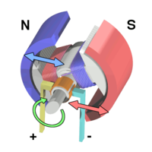
Electric Motor Analogy
Imagine a DC electric motor system with the following attributes:
Constant amperage
Variable voltage
Voltage-limited linear amplifiers
Motors that never burned out
How would this system behave?

Slide 6
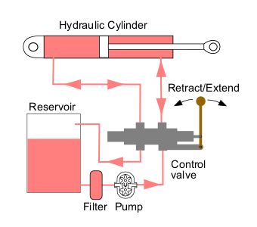
Typical Hydraulic System

Slide 7
System Attributes
“Force is free”
All movement is expensive
Movement requires power (Flow X Pressure), regardless of physical load
Any actuator (subject to flow limitations) can produce up to full system power
Closed valves produce rigid actuators
Abrupt changes in valves produce abrupt mechanical movements

Slide 8
Example Hydraulic Systems

Slide 9
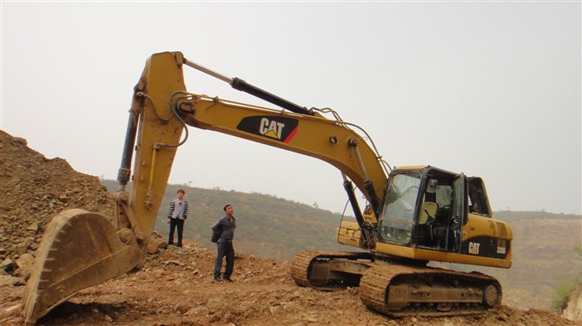
CAT 320D L

Slide 10
CAT 320D L
CAT 320D L Medium-Class Excavator
52,000 lb operational weight
6,000 lb arm
46,000 lb drawbar pull
35 foot horizontal reach
25 foot digging depth
20,000+ lbf digging force

Slide 11
CAT 320D L
How much power can the CAT 320D L Excavator’s engine generate?

Slide 12
CAT 320D L

Slide 13
CAT 320D L
148 horsepower

Slide 14

Kia Spectra 2002
How much power can my crappy Kia Spectra’s engine generate?

Slide 15
Kia Spectra 2002
126 horsepower

Slide 16
Wait. What?

Slide 17
Why?
Hydraulics offer perfect liquid gearing between the powerplant and actuators
Each joint’s performance is exactly bounded by cylinder size, cylinder placement, valve size, and system pressure
Raw power at low speeds = high forces

Slide 18
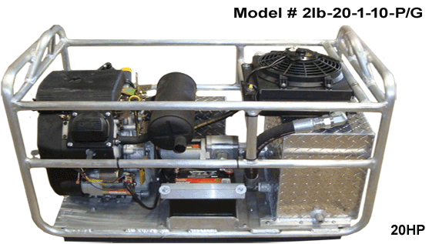
Hydraulics
Engine
Pump

Slide 19
Hydraulics
Hydraulics look “small”
Fluid is incompressible; no big chambers are required for compression
Limitations on size: material properties, bearing ratings
Trade size for heat generation

Slide 20
Hydraulics Safety

Slide 21
Hydraulics Safety
Hydraulic systems can harm you in multiple ways. They can easily:
Burn you
Cut off limbs
Cause gangrene
Cause blunt trauma

Slide 22
Hydraulics Safety
Maintain a significant distance between you and any working hydraulic equipment
Never service equipment while it’s running
Report any leaks immediately
Never leave a fitting partially tightened; either it’s on or it’s off all the way
Beware leaks in hoses
Assume parts can fly off at any time

Slide 23
Requisite Terrifying Image

Slide 24
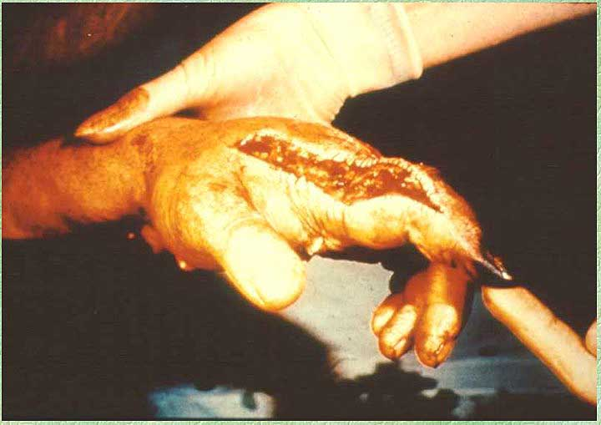
Hydraulics Safety

Slide 25
Hydraulic System Design

Slide 26
Typical Hydraulic System

Slide 27
Hydraulic System Design
A couple of standard components:
Pump system
Reservoir
Accumulator
Oil Cooler
Filters
Valves
Actuators

Slide 28
Pump System
Purpose:
Provide fixed pressure (generally, 1,500 to 5,000 psi) constantly, and flow on demand
Solutions (in order of price, low to high):
Create fluid flow constantly, but “dump” unused high pressure fluid (Industrial equipment)
Create fluid flow as needed using human-controlled pumps (Lawn mowers, hydraulic tools)
Create fluid flow as needed using mechanically-intelligent pumps (Airplanes, Boston Dynamics)

Slide 29
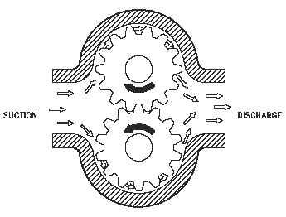
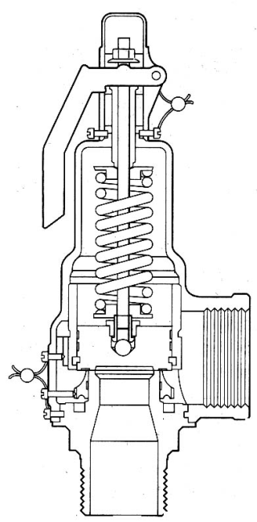
Gear Pumps/Relief Valves
Fixed displacement pump
Move X volume per revolution via interface between gear teeth and chamber wall
Engine spinning at a given RPM produces a given flow rate
Relief valve opens at Y psi
System builds up pressure to Y psi
Any flow past the system demand flows through the bleed valve and into reservoir

Slide 30
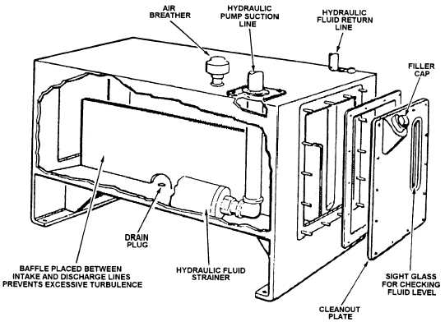
Reservoir
Purpose:
Hold excess fluid
Prevent turbulence
Cool fluid
Two main types of circuits:
Closed Circuit: No access to air. Reservoir is spring-loaded to a fixed low pressure.
Open Circuit: Ready access to air. Reservoir is at atmospheric pressure.

Slide 31
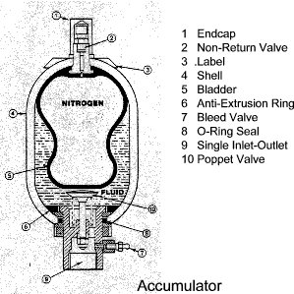
Accumulator
Purpose:
Even out flow spikes on high pressure side due to actuator demands
Solutions:
Embed a high-pressure gas bladder in a liquid tank
Spring-load a plunger

Slide 32
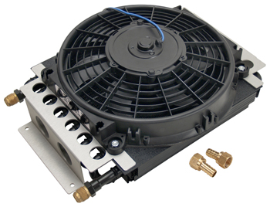
Oil Cooler
Purpose:
Hydraulic systems are generally <50% efficient; everything else becomes heat

Slide 33
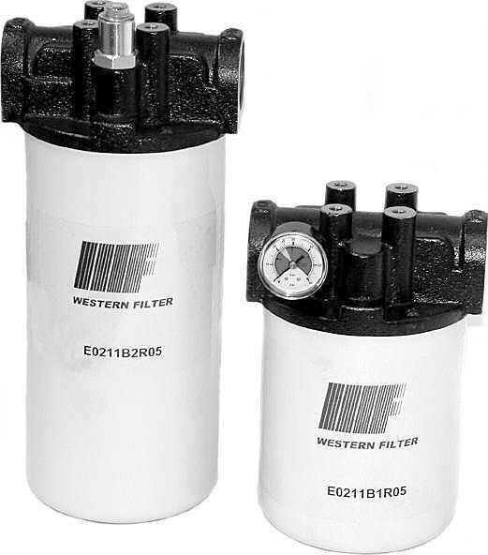
Filters
Purpose:
Keep particulates out of reservoir and pump
Particles as small as 10 microns can irretrievably damage a pump

Slide 34
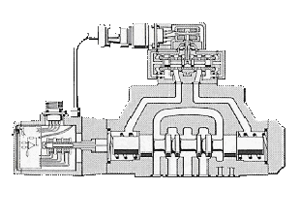
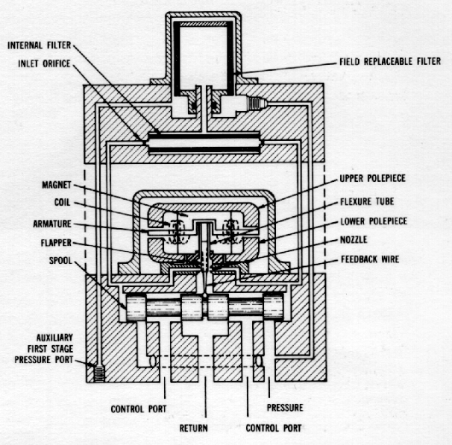
Valves
Purpose:
Control fluid flow to actuators
Solutions:
Solenoid valves (1 Hz; on/off)
Proportional valves (10 Hz; tuned spring, current-controlled coils)
Servo valves (100 Hz; small motors, tiny nozzles)

Slide 35
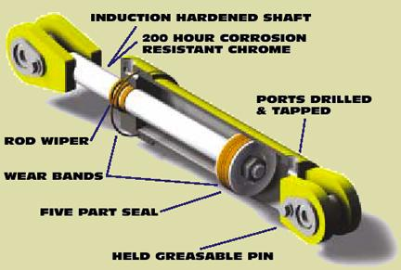
Actuators
Purpose:
Convert pressure and flow into force and velocity
Solutions:
Cylinders
Rotary motors
Retracting Area
Extending Area

Slide 36
Questions?

